Slide 1
EBAIIn2 - Intégration de données
Cathy Philippe

Slide 2
Le package gliomaData
Téléchargez le package gliomaData : http://biodev.cea.fr/sgcca
Installer le package avec la commande :
$ R CMD INSTALL gliomaData_0.4.tar.gz
library(tidyverse) library(gliomaData) data("ge_cgh_locIGR") ge <- ge_cgh_locIGR$multiblocks$GE dim(ge)
[1] 53 15702
cgh <- ge_cgh_locIGR$multiblocks$CGH dim(cgh)
[1] 53 1229

Slide 3
Analyse en composantes principales de l’expression des gènes
La fonction prcomp de R-base
res.pca <- prcomp(ge, scale. = FALSE) names(res.pca)
[1] "sdev" "rotation" "center" "scale" "x"

Slide 4
sdev
les écarts types des composantes principales, c’est-à-dire les racines carrées des valeurs propres de la matrice de covariance/corrélation.
head(res.pca$sdev)
[1] 38.07740 34.19387 29.27081 25.38139 22.64111 20.25702

Slide 5
rotation
La matrice des charges factorielles des variables (càd une matrice dont les colonnes contiennent les vecteurs propres).
Ce sont les corrélations entre les variables observées (originales) et les facteurs (ou composantes).
Elles indiquent à quel point chaque variable contribue à un facteur : + la charge est élevée, + la variable est fortement liée au facteur.
👉 En ACP, les charges sont les cosinus des angles entre les axes des variables et les composantes principales.
head(res.pca$rotation)
PC1 PC2 PC3 PC4 PC5 A_23_P212522 -0.012160235 -0.008619893 0.0006241499 -0.001370345 4.274409e-06 A_32_P30710 -0.001251253 -0.006089447 0.0069213794 0.001848697 -3.436176e-03 A_24_P470079 -0.003264395 -0.006669359 0.0034501429 -0.006671767 5.497904e-03 A_23_P65830 0.001820495 0.001325832 0.0030719736 -0.005142514 -5.222527e-03 A_23_P109143 0.007048612 0.004781884 -0.0124316938 -0.009063453 2.483269e-04 A_24_P932757 -0.008031082 -0.020481210 0.0166106863 0.015029387 -8.105594e-04 PC6 PC7 PC8 PC9 A_23_P212522 0.0062326792 -0.0124865873 -0.0047288695 0.0095672680 A_32_P30710 0.0002583856 0.0024541105 0.0040859856 0.0025144874 A_24_P470079 -0.0056457905 -0.0005013293 -0.0006713196 -0.0027364209 A_23_P65830 0.0052238460 -0.0001936418 0.0063465939 0.0033847126 A_23_P109143 -0.0026015325 0.0004716679 0.0098824774 0.0007116678 A_24_P932757 0.0012129700 0.0093703157 0.0009764959 -0.0139072445 PC10 PC11 PC12 PC13 A_23_P212522 0.0092248511 -7.227398e-03 -0.0076257868 -0.004928804 A_32_P30710 0.0015006735 3.801763e-05 0.0041776060 0.006721266 A_24_P470079 -0.0046916463 9.846797e-04 0.0042078910 -0.001060836 A_23_P65830 0.0007306805 -1.644394e-03 0.0040475089 0.010492337 A_23_P109143 -0.0046878753 -6.191989e-03 -0.0099253796 -0.005511380 A_24_P932757 -0.0055409392 8.232353e-03 0.0005684415 -0.008570986 PC14 PC15 PC16 PC17 PC18 A_23_P212522 6.074065e-05 -0.003633174 0.005656698 -0.0019401376 -0.007278156 A_32_P30710 5.524108e-03 -0.001925426 -0.004873837 -0.0036735476 -0.001075127 A_24_P470079 6.500123e-03 -0.006489514 0.001608821 -0.0012715317 -0.001213528 A_23_P65830 2.475401e-03 0.007222413 0.003177603 0.0029909292 -0.004216719 A_23_P109143 3.150060e-03 0.005149093 0.016033021 0.0005267546 -0.003647794 A_24_P932757 -2.413900e-03 0.002502899 -0.013138631 0.0203233202 0.010905709 PC19 PC20 PC21 PC22 A_23_P212522 -0.0045833164 -0.0014366905 0.017231508 0.0008784338 A_32_P30710 0.0011367413 -0.0010056198 0.001175475 0.0019252383 A_24_P470079 -0.0006625924 -0.0045984407 0.005399371 0.0097075866 A_23_P65830 -0.0057515142 -0.0003733501 -0.006791557 -0.0094411989 A_23_P109143 0.0007413642 0.0065476115 0.020359863 0.0053279842 A_24_P932757 -0.0072075522 -0.0065484758 0.002046330 0.0087763227 PC23 PC24 PC25 PC26 A_23_P212522 0.0002233584 -0.002954164 -0.0165509886 0.005628975 A_32_P30710 -0.0060443880 -0.001363731 -0.0002338502 -0.004448363 A_24_P470079 0.0131166235 -0.002671880 0.0023796321 0.006136490 A_23_P65830 -0.0036927804 0.001706706 0.0010605460 -0.008749593 A_23_P109143 -0.0006694981 0.002876245 -0.0051130551 0.010594493 A_24_P932757 -0.0056878516 0.006325286 -0.0037464652 -0.020666228 PC27 PC28 PC29 PC30 PC31 A_23_P212522 0.0212510407 0.0076836869 0.015119542 0.011492472 -6.324250e-03 A_32_P30710 -0.0074030267 -0.0010771305 0.004437106 0.010162378 5.334358e-03 A_24_P470079 0.0009442087 -0.0037145458 0.003427810 0.005232319 -3.866169e-05 A_23_P65830 0.0053244519 0.0006344789 0.005683271 -0.004758470 -3.887711e-03 A_23_P109143 -0.0046033587 0.0039333062 0.008585503 -0.001417893 -4.310245e-03 A_24_P932757 -0.0020351662 0.0088939472 0.001949920 0.001920204 -1.080052e-02 PC32 PC33 PC34 PC35 A_23_P212522 0.0058328382 0.0031121441 0.0129924879 -0.0013563548 A_32_P30710 0.0007809129 0.0036828356 0.0009351453 0.0009611616 A_24_P470079 -0.0057043913 -0.0058390860 0.0011190243 -0.0030706464 A_23_P65830 -0.0015398815 0.0041972044 -0.0042954940 0.0089903270 A_23_P109143 0.0028549763 -0.0007763133 0.0019131793 0.0064971403 A_24_P932757 -0.0094010486 -0.0084960685 -0.0067222155 0.0061108467 PC36 PC37 PC38 PC39 A_23_P212522 1.453751e-03 0.0105460406 0.0075313027 0.0053302408 A_32_P30710 2.639560e-04 0.0023144820 -0.0004592683 0.0010933670 A_24_P470079 9.676685e-05 -0.0059112753 -0.0040123675 -0.0024613270 A_23_P65830 5.725371e-03 0.0006157831 -0.0016715551 0.0059478721 A_23_P109143 -6.869689e-03 -0.0042107365 0.0106555131 0.0007562475 A_24_P932757 9.653765e-04 -0.0033720351 0.0099076081 -0.0116890203 PC40 PC41 PC42 PC43 PC44 A_23_P212522 -0.003020623 0.018476461 0.0004840937 -1.927180e-02 0.011292465 A_32_P30710 -0.004217168 -0.003551412 0.0055600602 9.219686e-05 0.003268225 A_24_P470079 0.004007319 0.004259994 0.0072080609 8.697258e-05 -0.002040912 A_23_P65830 -0.003546135 -0.007680559 -0.0041935224 -4.998289e-03 0.010116531 A_23_P109143 0.008800181 0.009397512 -0.0032528736 -3.665148e-03 -0.013627013 A_24_P932757 0.004376051 -0.008322184 0.0008622626 2.567201e-04 -0.005686081 PC45 PC46 PC47 PC48 PC49 A_23_P212522 0.003466617 -0.014183817 -5.643661e-03 0.0061560564 -0.002718383 A_32_P30710 -0.001153464 0.001717203 3.259414e-05 0.0009362043 -0.001108446 A_24_P470079 0.002129949 0.005423050 1.344340e-03 0.0081664310 -0.003535510 A_23_P65830 -0.001393176 -0.002209355 -1.009010e-03 -0.0070191723 0.002175512 A_23_P109143 -0.009230832 0.006104638 1.505804e-03 -0.0068358600 0.001609542 A_24_P932757 -0.012303917 0.003244714 4.516782e-03 0.0061116576 0.003827452 PC50 PC51 PC52 PC53 A_23_P212522 -1.104294e-02 0.0046869691 0.006038838 -0.20856519 A_32_P30710 -4.254538e-03 -0.0009565384 0.004779032 -0.07923912 A_24_P470079 -8.921722e-03 -0.0078811299 0.020305491 0.04504946 A_23_P65830 3.644917e-04 -0.0008742626 0.011503284 0.02948064 A_23_P109143 -3.912886e-03 -0.0052956556 0.003851484 0.02157673 A_24_P932757 -2.626192e-05 0.0021263247 -0.004547231 0.03569620

Slide 6
center
La moyenne de chaque variable.
head(res.pca$center)
A_23_P212522 A_32_P30710 A_24_P470079 A_23_P65830 A_23_P109143 A_24_P932757 0.09414062 0.79474540 0.59566762 -0.72609461 -1.91230509 3.77429305

Slide 7
scale
La variance de chaque variable.
head(res.pca$scale)
[1] FALSE

Slide 8
x
la valeur des données rotatées : les données centrées (et éventuellement réduites) multipliées par la matrice de rotation.
head(res.pca$x, n = 6)
PC1 PC2 PC3 PC4 PC5 PC6 PC7 P01 27.76234 -75.070096 15.601716 -12.4802994 22.301523 -1.480638 4.360086 P02 -22.36057 6.518867 1.658008 -57.2290494 -25.058922 -2.311333 -30.523645 P03 39.78780 -32.046108 38.421071 -3.5281183 -2.520405 26.536103 34.703937 P04 21.29036 -10.918556 28.352914 21.8013057 21.103978 -5.880404 2.790414 P05 44.30987 5.258756 21.833719 0.1615616 -16.731945 -32.149962 20.900340 P06 -69.26055 -33.939985 -8.995758 3.9299622 4.927449 -10.102584 21.852158 PC8 PC9 PC10 PC11 PC12 PC13 PC14 P01 -9.393903 43.26881 -21.229600 24.539518 -6.058532 40.997726 -5.0441778 P02 20.885015 -11.36456 -1.464040 4.147095 25.665250 23.734556 20.4962863 P03 -17.263955 18.16281 -9.358950 -19.469750 -7.791948 9.424723 15.0310480 P04 2.541886 -14.81270 -8.602144 -9.911321 9.447600 10.005271 -15.8846834 P05 -11.917910 1.92338 11.807211 8.613584 7.372093 7.910270 -0.5294018 P06 -12.894390 -29.84692 6.242375 -38.724105 -12.041610 19.070056 -8.6740996 PC15 PC16 PC17 PC18 PC19 PC20 PC21 P01 -13.311647 22.854812 0.1799697 -7.799883 43.106537 8.110722 12.126390 P02 -27.481912 -34.623144 3.0496452 -6.245401 13.535513 9.835904 6.957339 P03 -4.265227 -2.754922 -18.3871300 3.190408 -15.493955 11.706624 1.680948 P04 12.468903 12.200034 17.6648025 8.837212 -11.473638 7.411799 2.967409 P05 22.111793 -6.753704 21.5584838 -2.204116 5.115605 -4.872056 7.771854 P06 -19.419036 11.449003 -4.7705877 9.681152 -1.689946 -18.763624 12.067066 PC22 PC23 PC24 PC25 PC26 PC27 P01 -1.5387291 -3.255867 -5.4444411 -5.306344 -13.796396 10.2762876 P02 13.7427745 -3.748738 20.5467565 31.268651 4.924451 -5.5299822 P03 1.9349223 -3.079357 -0.7758917 5.487228 1.199811 -2.2044691 P04 5.3881845 1.752169 19.5158353 10.293805 -18.585028 -0.1664762 P05 0.8590946 -16.845426 -6.9018116 -3.292704 5.270542 -9.9676171 P06 8.2058189 9.983173 -11.6722230 2.291299 -1.447672 -24.2789928 PC28 PC29 PC30 PC31 PC32 PC33 PC34 P01 4.005557 2.8834101 -6.638846 -14.528647 4.858872 8.0194051 3.514910 P02 1.909716 13.8392978 -8.219374 11.379509 -10.506279 -2.3656773 -4.480085 P03 -1.892099 -0.8445373 -4.585050 -3.734951 -17.238213 -21.1378689 -17.531500 P04 -8.471938 -9.2359808 12.904157 8.483118 2.142332 0.8079683 -6.170960 P05 6.497752 -4.5851394 2.854874 10.111009 -31.560959 7.0601563 13.518110 P06 -3.114334 -3.7787241 -9.203673 -3.884755 -13.577679 7.6139406 -3.381075 PC35 PC36 PC37 PC38 PC39 PC40 PC41 P01 4.606103 2.749241 -1.808904 -8.2367026 -1.365029 -3.131921 3.426429 P02 -5.790089 1.996422 -6.828115 -2.6337209 4.860227 2.370969 4.119938 P03 8.486880 5.428095 -2.101855 -0.2013222 -12.896057 11.183075 -7.905435 P04 -6.077890 -2.386825 -12.219482 -17.3376721 4.279584 -4.944795 1.200745 P05 11.056372 -8.482257 20.008737 -6.6111223 19.201813 -5.851110 -8.523235 P06 7.894851 6.514108 -12.469003 1.1870361 -1.083316 -10.148898 3.424718 PC42 PC43 PC44 PC45 PC46 PC47 P01 0.6691749 2.7448517 0.6811543 2.0092146 0.5870819 -3.825970 P02 -1.9557573 2.6665162 0.2875328 0.3900017 -3.0145664 -3.452078 P03 2.0574795 -10.2732018 8.9065618 -20.9182471 -1.4402933 8.448059 P04 -5.0988875 -0.3989822 9.6313790 9.4482785 -1.6786660 23.495696 P05 11.7876229 2.2378014 0.4095551 -3.2022887 -7.7828315 3.567869 P06 5.1914466 -7.6001479 4.1846581 13.0622065 -1.1023578 -7.216748 PC48 PC49 PC50 PC51 PC52 PC53 P01 -0.7682908 -1.909207 1.954887 -0.9495765 0.08317379 1.346145e-15 P02 0.6734218 -1.253205 3.935379 0.5325188 0.25955112 6.668277e-15 P03 7.7016026 -1.273770 2.825672 -3.0325058 -1.25845002 1.366615e-14 P04 -8.5499261 -16.764786 2.330621 5.5170481 -0.18342289 1.010650e-14 P05 2.7341952 2.450407 1.231974 -1.3066736 -0.35072978 7.202572e-15 P06 -5.4888134 12.471891 -2.429406 5.4217874 -0.73823034 4.468648e-15

Slide 9
Visualisation de l’ACP
library(factoextra) loc <- factor(c("cort", "dipg", "midl")[ge_cgh_locIGR$ylabel])

Slide 10
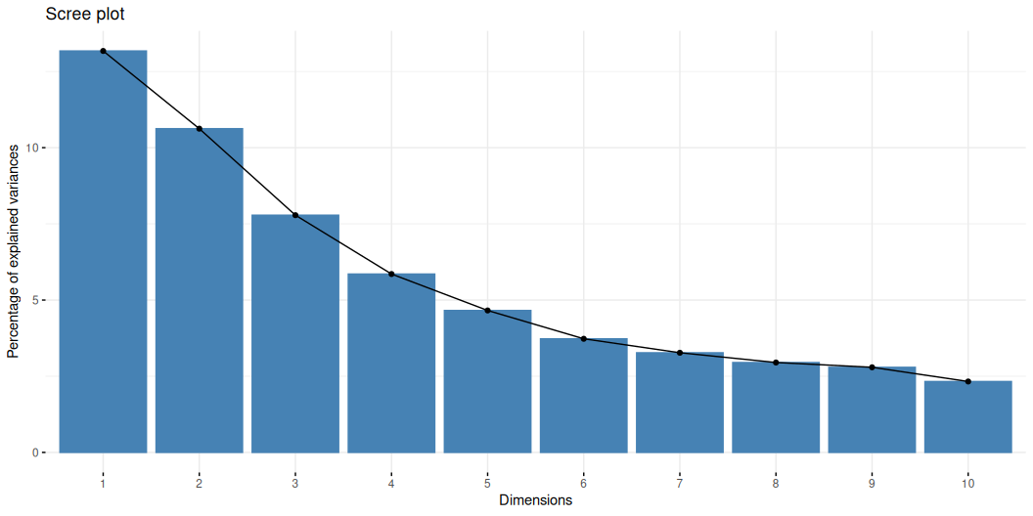
Le screeplot
fviz_screeplot(res.pca)

Slide 12
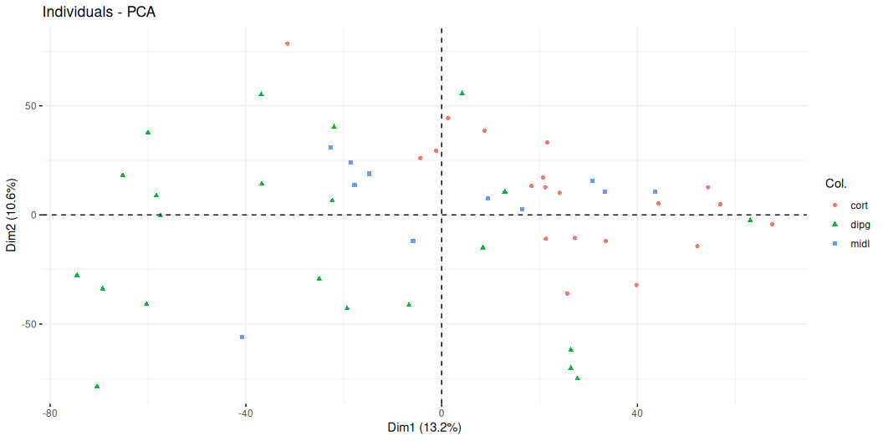
Les observations
fviz_pca_ind(res.pca, geom = "point", col.ind = loc, invisible = "quali")

Slide 13
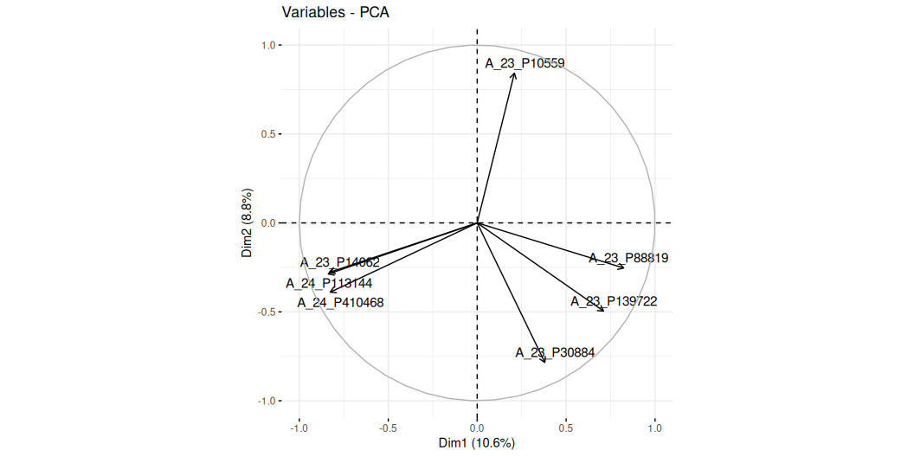
Le cercle des corrélations (variables)
res.pca.scale <- prcomp(ge, scale. = TRUE) fviz_pca_var(res.pca.scale, select.var = list(contrib = 7), repel = TRUE)

Slide 14
Paramètre blocks
class(ge_cgh_locIGR$multiblocks)
[1] "list"
names(ge_cgh_locIGR$multiblocks)
[1] "GE" "CGH" "y"
my_blocks = ge_cgh_locIGR$multiblocks

Slide 15
Paramètre connection
design = matrix(rep(1,9), nrow=3, ncol=3) D = diag(1, 3) my_design = design - D my_design
[,1] [,2] [,3] [1,] 0 1 1 [2,] 1 0 1 [3,] 1 1 0

Slide 16
Paramètre response
... response = 3 ...

Slide 17
RGCCA sur gliomaData
library(RGCCA) my_rgcca_fit = rgcca(blocks = my_blocks, connection = my_design, response = 3, ncomp=2) print(my_rgcca_fit)
Fitted RGCCA model. The algorithm converged to a stationnary point: - After 6 iterations for component 1. - After 15 iterations for component 2.

Slide 18
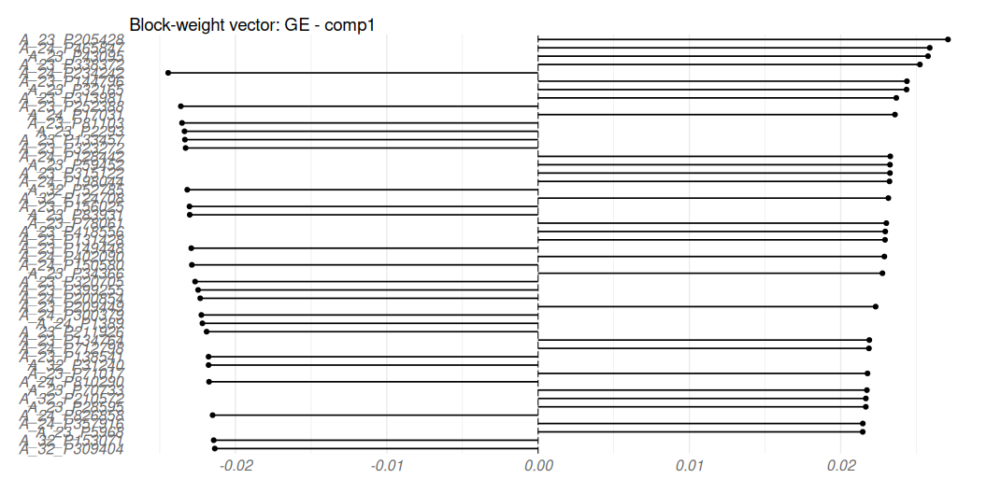
Graphe des poids block 1
plot(my_rgcca_fit, type = "weight", block = 1, display_order = T, n_mark = 50)

Slide 19
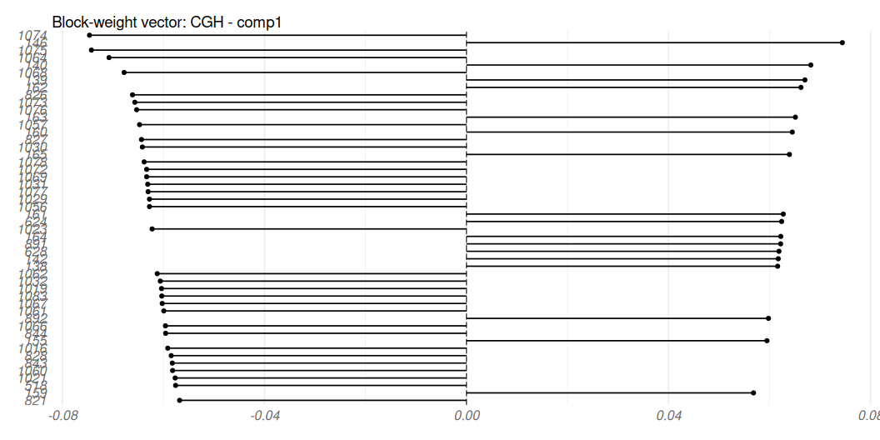
Graphe des poids block 2
plot(my_rgcca_fit, type = "weight", block = 2, display_order = T, n_mark = 50)

Slide 20
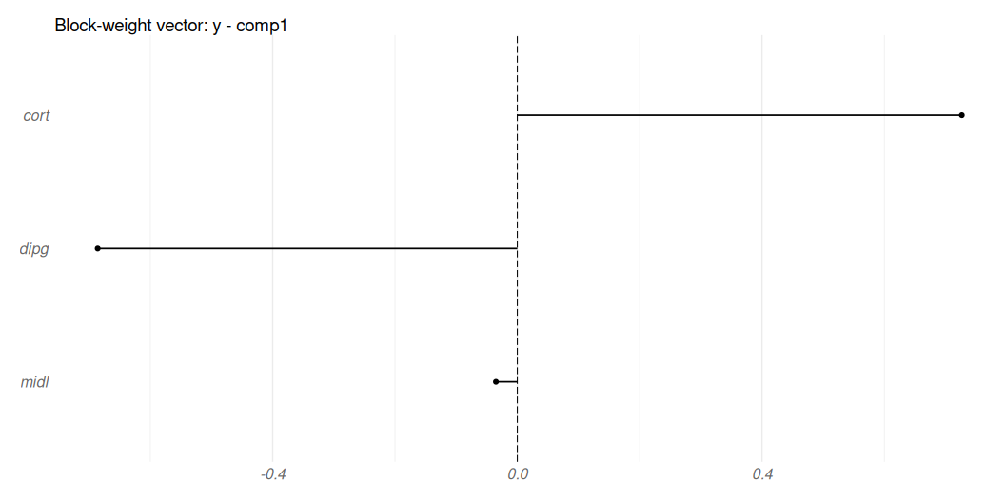
Graphe des poids block 3
plot(my_rgcca_fit, type = "weight", block = 3, display_order = T)

Slide 21
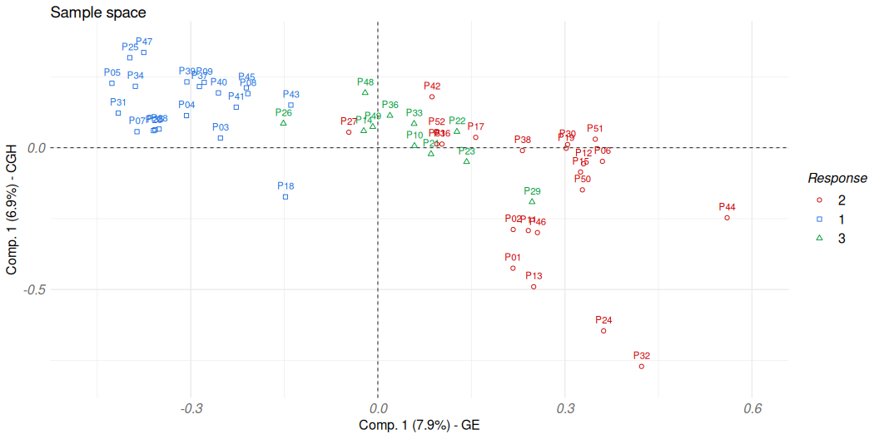
Graphes des individus
plot(my_rgcca_fit, type = "sample", block = 1:2, comp = rep(1, 2), resp = as.factor(ge_cgh_locIGR$ylabel) )

